Slide 1
Layout Lab
Front-End Web Development

Slide 2
Build a Real Website
Layout Lab

Slide 3
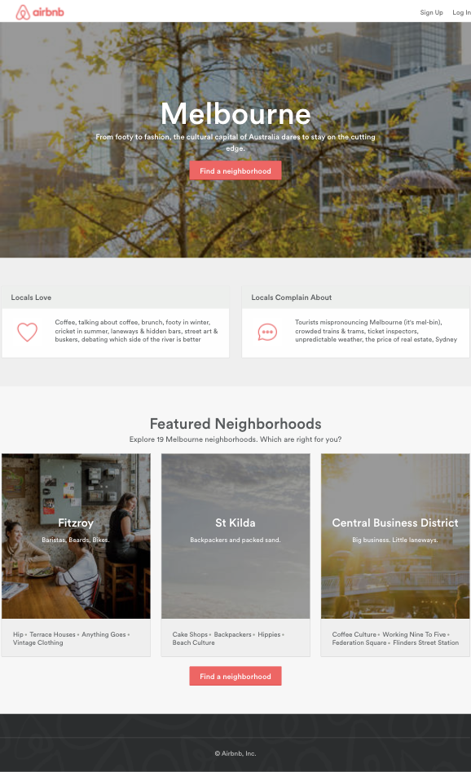
Build a Real Website
120 minutes
You’re going to build the site pictured to the right (deep breath).
This will be difficult but doable. Let’s start it off together and frame out our approach.
Starter code:
https://drive.google.com/drive/folders/1Av21cDcCudU_sQjnU8diWVD9EJ3xiPy_?usp=sharing
Solution code:
https://drive.google.com/drive/folders/1g8ewKDu6HthfQRkngKU4ak9MzJhcR4jK?usp=sharing

Slide 4
Identifying Sections of the Site
Let’s identify sections of the site that can be built independent of each other.
We can break down the HTML and CSS that we need, based on the content and layout.
A few hints on some of the advanced pieces of this site:
The hover effect on the Find a Neighborhood button requires pseudo-selectors.
The dark overlay in the picture requires pseudo-selectors and the position property.

Slide 5
The Sections Are...
1
There are five sections on the site:
Header / navigation
Main background image section (with Find a Neighborhood button)
Locals section with two columns
Featured neighborhoods section with three columns
Footer
Each section stacks one on top of the other. They can be built separately, and you should focus on them one by one as you build your site.
2
3
4
5

Slide 6
The Header
15 minutes
1
The first section: the header
Header-only solution code
We seem to have two sections of content, one on each side of the page
How can we get this layout in flexbox?

Slide 7
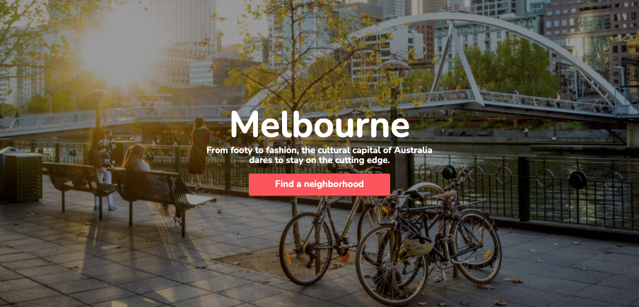
2. The Main Background
30 minutes
The second section: the main background image.
Main background image only solution code
How can we set the image to show up in the background?
Does an element get height from a background image?
How can we center the content inside of the background image?
Bonus: how can we darken the background image?
2

Slide 8
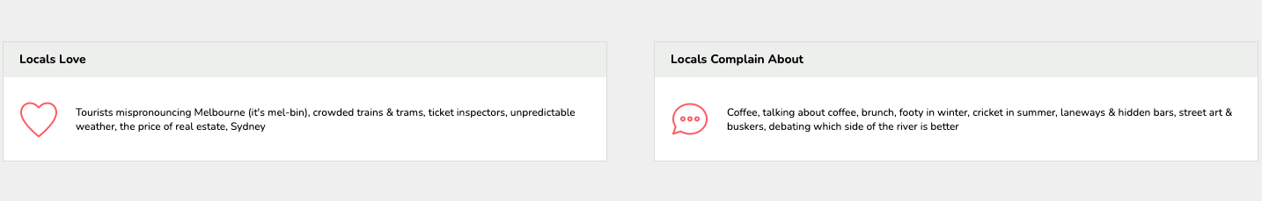
3. Locals Section
30 minutes
The third section: the locals.
Locals-only solution code
How many columns do we see in this section?
Is the layout identical or close to identical in each column?
If so, we can focus on building one column at a time
Once one column is built, we can copy/paste that code to create the other columns (all we have to do is edit the content/HTML)
3

Slide 9
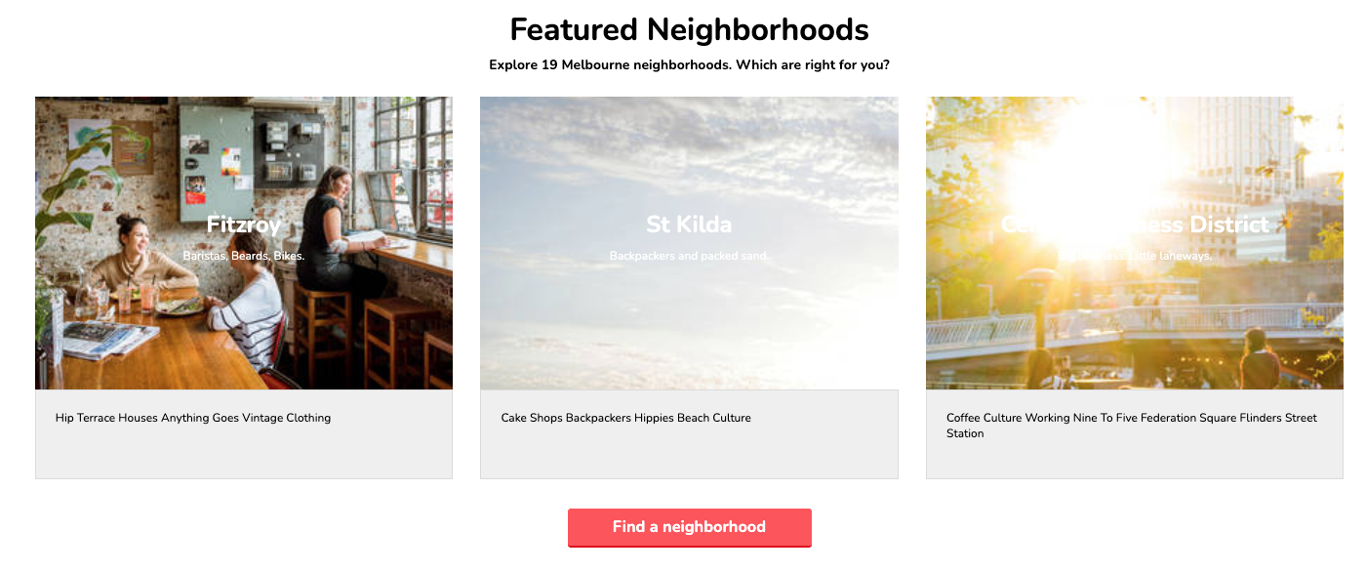
4. Featured Neighborhoods Section
30 minutes
4
The fourth section: the neighborhoods.
Neighborhoods-only solution code
We see a few rows of centered content, and a three column row.
There are a few similar concepts from previous sections:
Each column has similar layout, so we can just focus on building one and then copying that HTML structure to the other columns
Centering content within (or on top of) a background image

Slide 10
5. The Footer
15 minutes
The fifth section: the footer.
Footer-only solution code
5

Slide 11
Key Takeaways
For Next Time
Fonts + Layouts = Style Points!
Basics of Responsive Design
Always provide a system font fallback option when using custom fonts.
Pseudo-selectors help target context-specific elements.
Layouts are hard and come with practice.
Complete Homework 3.
Responsive design ensures a good user experience across all device sizes.

